Slide 1

City Manager
(מנהל אזור)
Area Manager
(רכז גרעין)
Team Owner
Student/ Volunteer
Registration and login
Admin
התקדמות שיפוץ: זהה לחניך גרעין
כל תפקידי מנהל האזור ובנוסף:
כל תפקידי רכז הגרעין ובנוסף:
צפה בקבוצה
הצטרפות לקבוצה
רישום תלמיד
ניהול בית: צפייה ועריכת פרטים
שינוי תאריך הגבלת הרישום
ניהול בית: הוספת בית
צפייה פרטי בית
יציאה מקבוצה
רישום סגל
ניהול בית: הוספה, הסרה ועריכת מטלה
פעולות האדמין וכנראה נוספות (שלא הכרחיות לתפעול היום) יצטמצמו בגרסה הקרובה
הפעלת אלגו' השיבוץ
ניהול קבוצה: ייצוא פרטי בית ספר
ערוך התקדמות קבוצה
צפייה בפרטי בית
התחברות
ניהול קבוצה: הוספה והסרת חברי קבוצה
פרסום שיבוץ
ניהול גישות: טיפול בבקשה
ניהול קבוצה: צפייה בתגובות מיוחדות
ערוך פרטים אישיים
הוספה\הסרה\ עריכה של אזור\שכונה\ בית ספר
ניהול גישות: שינוי גישה
ניהול קבוצה: השמת ראש קבוצה
ניהול שיבוץ: שינוי השמה
כל הפעולות יראו למשתמש את הפרטים שרלוונטיים רק לאזורו

Slide 2
פעולות כלליות

Slide 3
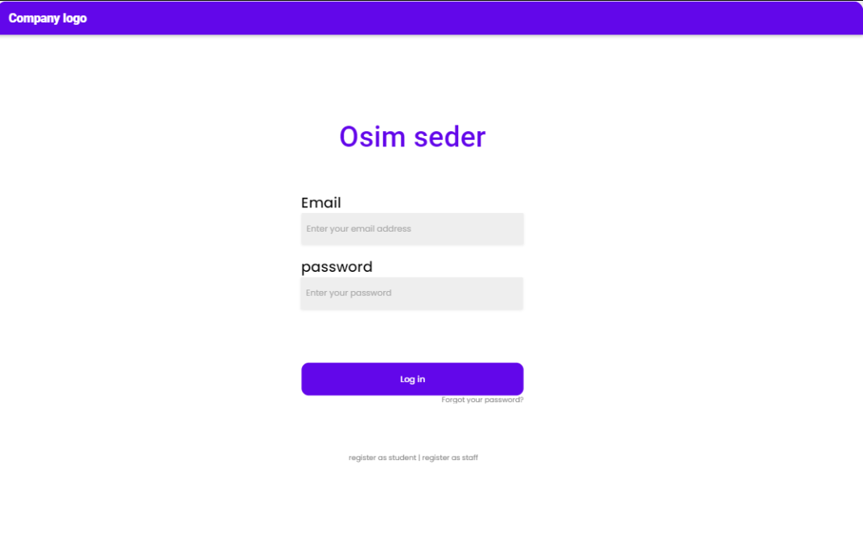
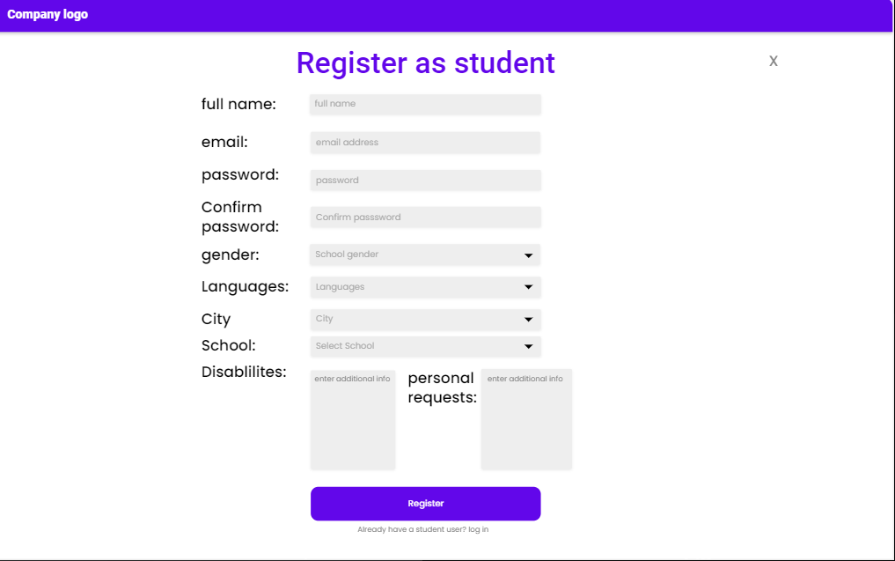
רישום תלמיד
חזרה
a. A student (without a user) enters the website "Osim Seder“.
b. Clicks on "Register as a student".
c. Fills in his details: Name, Phone, parent contact (name, phone and email), Gender, City, School, Personal Requests, Disabilities, Languages and press “Register"
d. The system reads the information and registers the student in the system.
e. The system sends an email for the user parents for him to access a permitting form to approve and notifies the user about it.
f. The user can access the account, see personal details, join groups and see details of them. But it will write to him that he hasn’t been approved
A confirmation email was sent to your account, please approve to activate your account
*e and f are relevant only if need parent approval, update us if not
* If yes, The reason why to let the student do actions is to not hold him back in the day they are told about the web-app. You want to know the status of all students and if they are registered and not only after their parents approve (it can wait to the last week before the event)

Slide 4
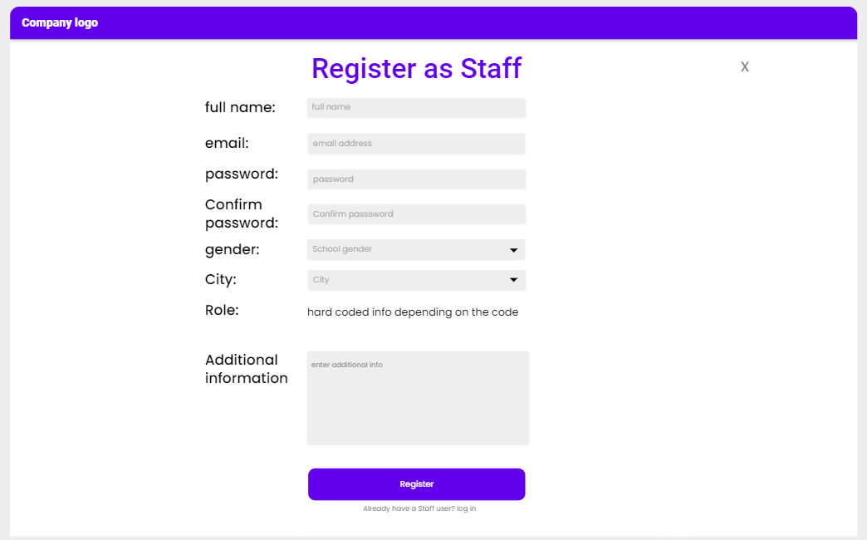
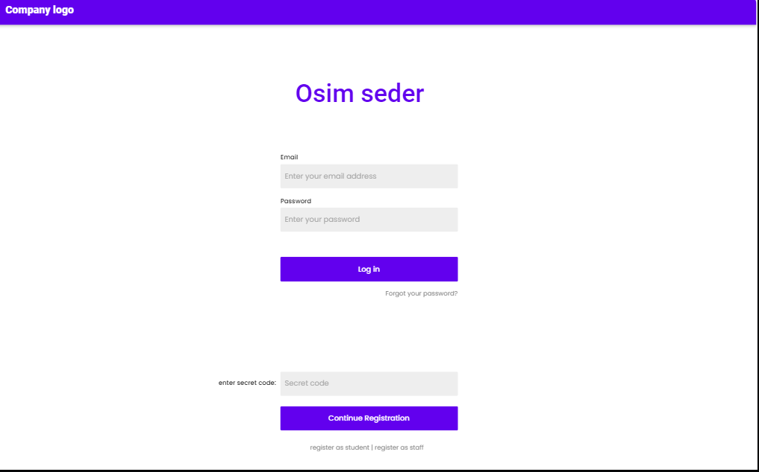
רישום סגל
חזרה
a. Person (without a user) enters the website "Osim Seder“
b. Clicks on "Register as staff".
c. The Staff member inserts a code pre-defined and fixed to his role.
d. Fills in his details: Name, Phone, area and neighborhood (if relevant). There is also a role field that is unchangeable.
e. The system reads the information and registers the Team Owner in the system.
f. The system sends an email for the user for him to approve and notifies the user about it.
g. After the user approves, the user is able to access his account and make actions with it.
A confirmation email was sent to your account, please approve to activate your account
Will be relevant mostly to team owners, as most of the other users will probably be hard-written in the database

Slide 5
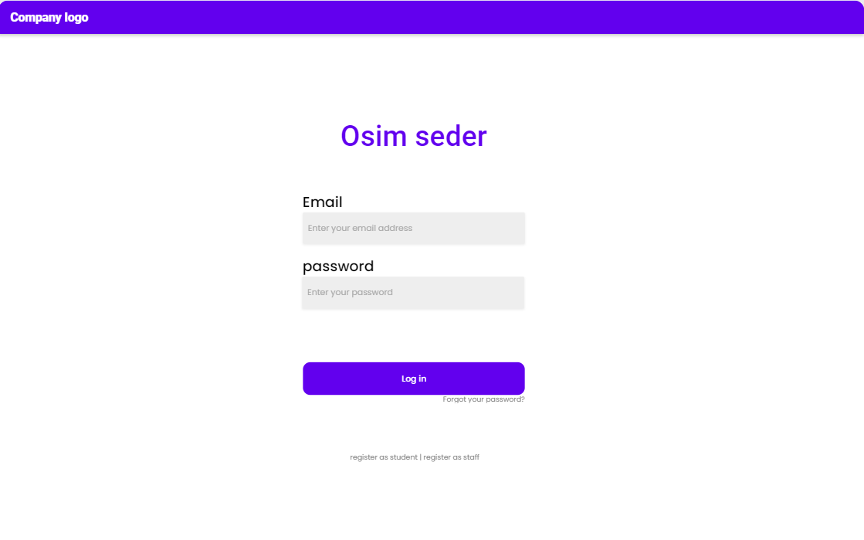
התחברות
חזרה
All Roles:
a. Person enters Phone and Password and clicks on “login”.
If server authenticates the user:
Logged in.
Else:
an error message will appear to the user.

Slide 6
פעולות תלמיד

Slide 7
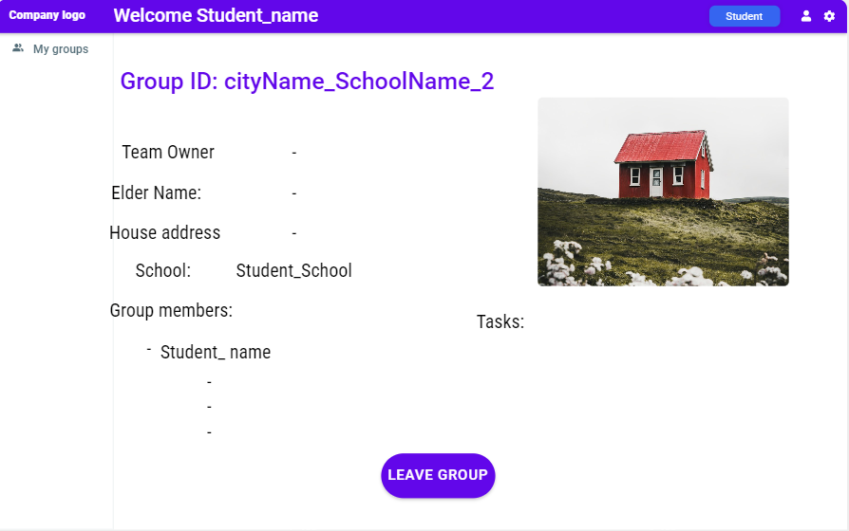
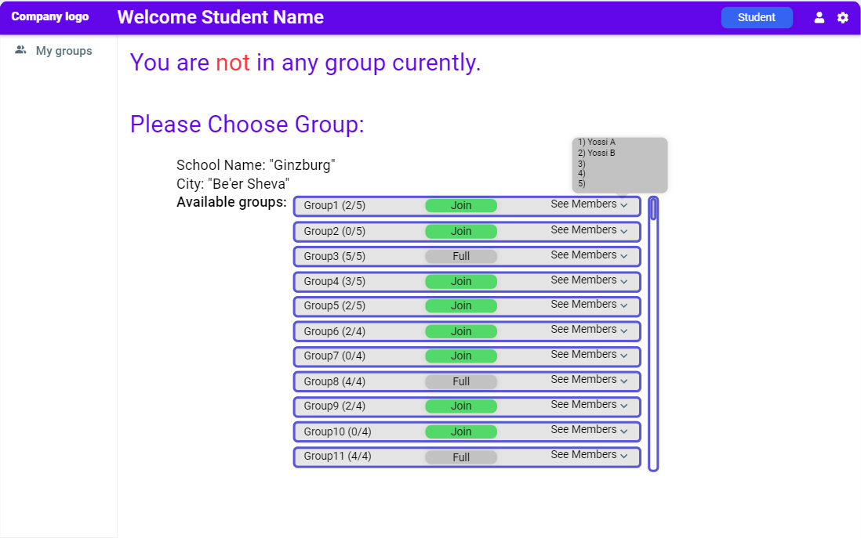
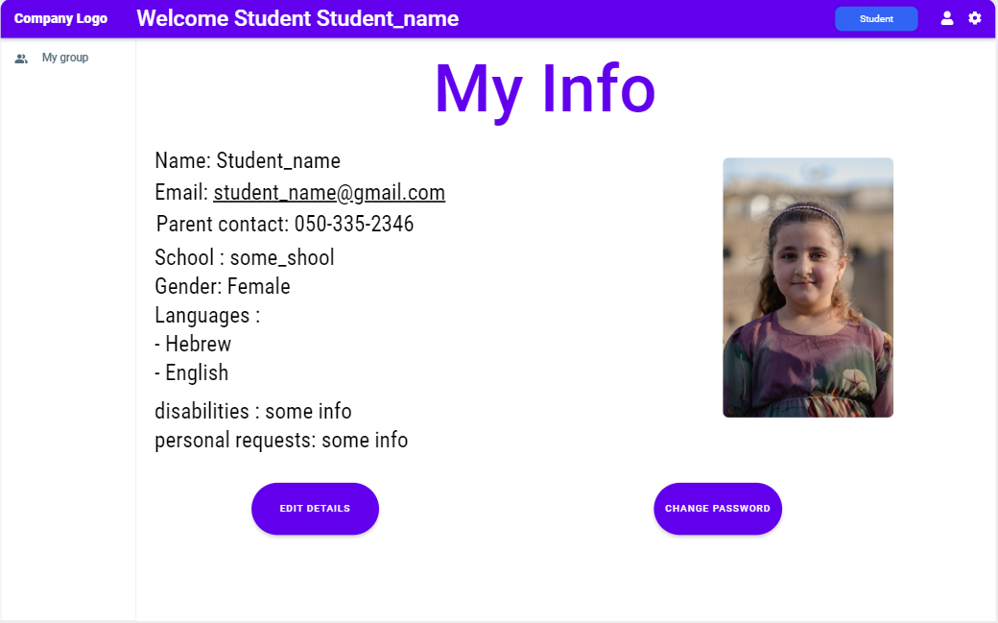
הצטרפות לקבוצה
חזרה
Precondition: user is logged in of type student and not in a group.
User click on “My Group” tab
b. User views all the groups he has available for him (as being a part of its school(.
The student can view the members that are part of the group.
If the group has available space in it, the user can join the group by pressing the “Join” button
c. In case of success, the system will change the group view to the wanted group enlisting the other group members and (if assigned) the house details, tasks, and team owner (if assigned).

Slide 8
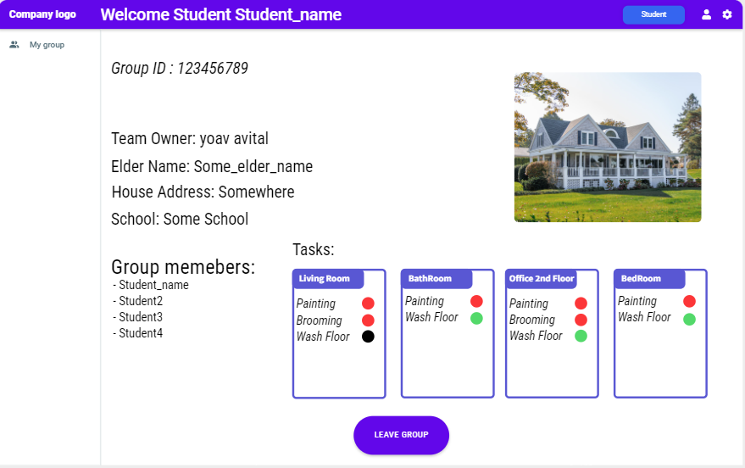
יציאה מקבוצה
חזרה
Precondition: user is logged in of type student and in a group.
User clicks on “Leave group.”
b. The system will remove the user from the group.

Slide 9
צפייה בפרטי בית
חזרה
Precondition: user is logged in of type student, in a group and a house is assigned to the group (after group-to-house allocation).
User clicks on “Group” tab.
b. The system will display the house information to the user:
Tasks for the house
House address
Name and phone number of the elderly and Team Owner.

Slide 10
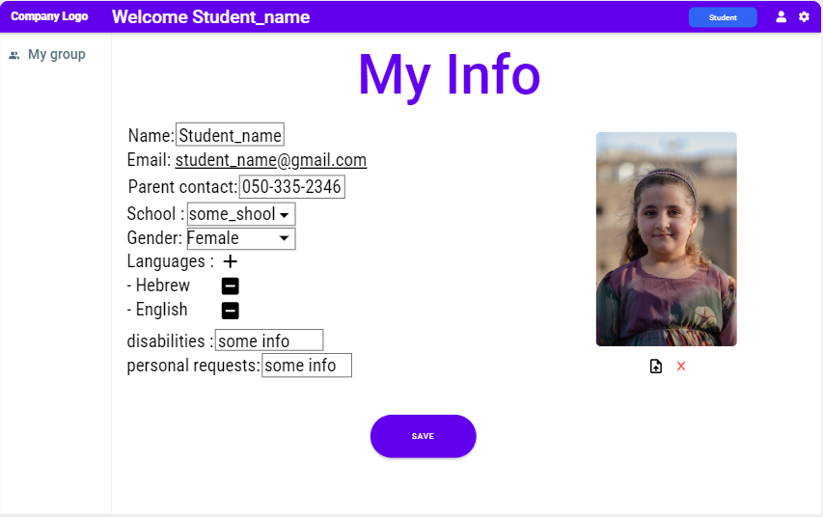
ערוך פרטים אישיים
חזרה
Precondition: user is logged in and in “settings” tab.
a. User clicks on the “Person” icon in the header.
b. User can add/edit/remove his details besides email including:
Disabilities
Personal Requests
Languages
c. User clicks on “save” button to implement the changes in the system.
d. The changes are saved in the system.

Slide 11
פעולות חניך גרעין Team Owner

Slide 12
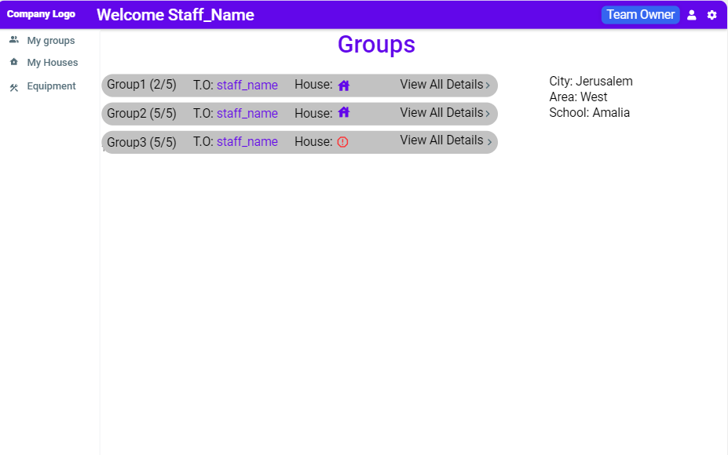
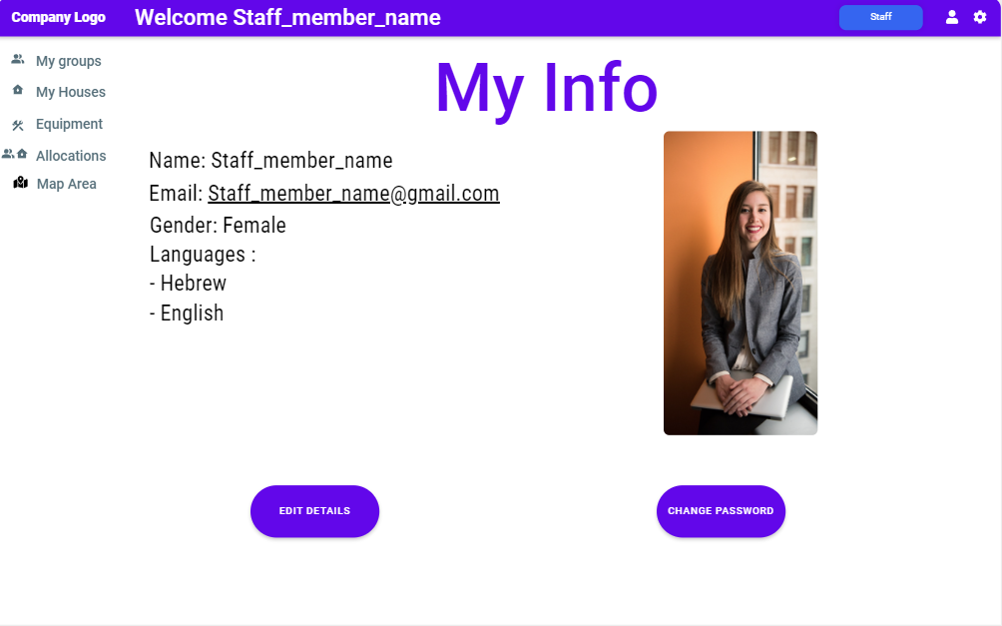
צפייה בפרטי קבוצה
חזרה
Precondition: user is logged in and is a T.O.
User clicks on the “groups” tab.
b. User views the list of all the groups under his authority.
c. Each Group consist:
ID
Team Owner Name
Location (Area/ City)
List of registered Students
d. Given the group has a house enlisted, he could direct himself through the house icon to get into the specific house.

Slide 13
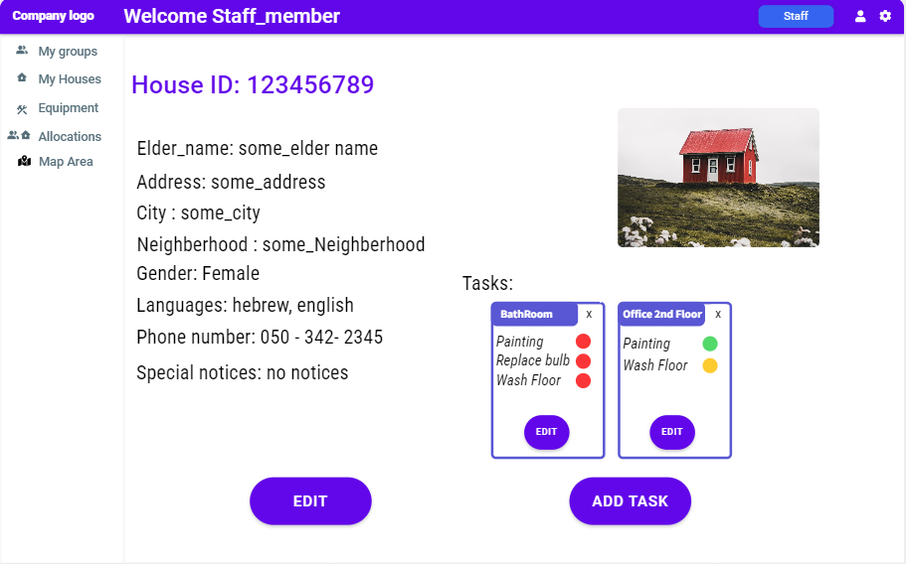
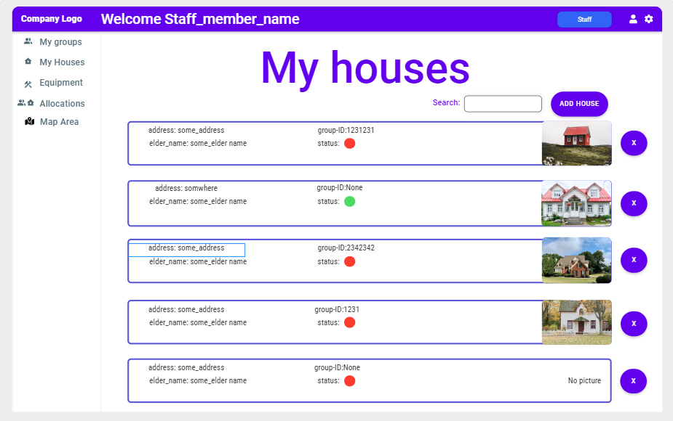
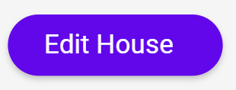
צפה בפרטי בית
חזרה
Precondition: user is logged in, of type “Team Owner” and has at least one group assigned to him.
User clicks on the “My Houses” tab.
b. User selects the relevant house (of the houses he is owning).
c. The system will present the user with the following info:
Tasks for the house, Supplies, House address, name and phone number of the elderly.
For each task – status (completed or not).

Slide 14
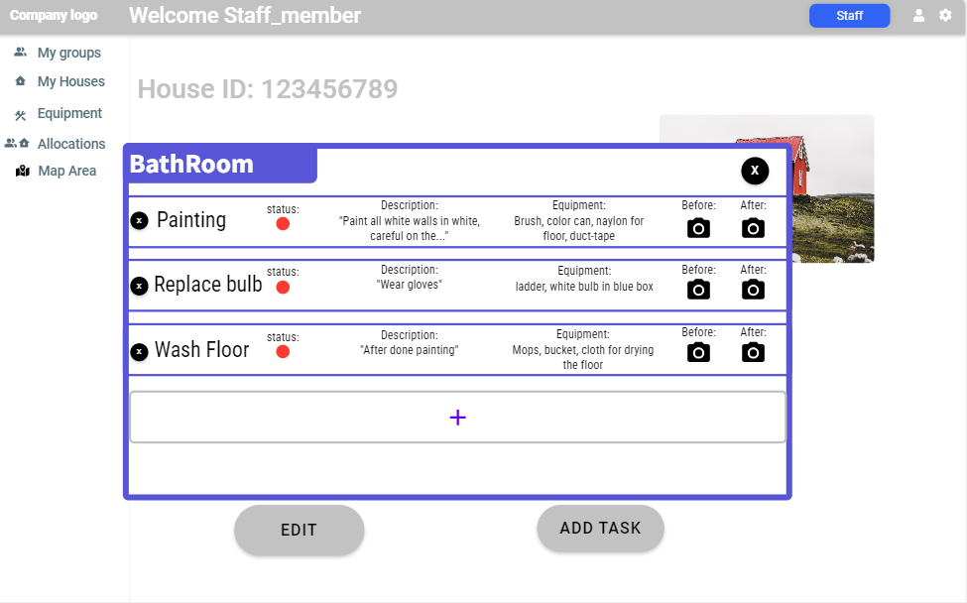
ערוך התקדמות קבוצה
חזרה
Precondition: user is logged in, of any non-student type.
a. User clicks on the “My Houses” tab.
b. User selects the relevant house (of the houses he is owning), including the enlisted tasks.
c. The system will present the user with the following info:
Tasks for the house, Supplies, House address, name and phone number of the elderly.
For each task – status (completed or not).
d. If the team owner wants to change the status of a given task (if task is not done yet):
User clicks on the task color and choose the status of the task.

Slide 15
פעולות רכז גרעין Area Manager

Slide 16
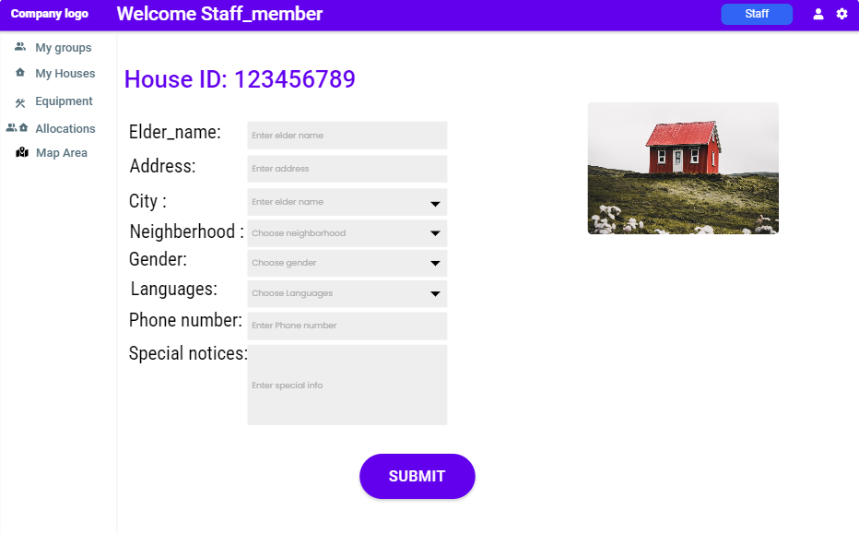
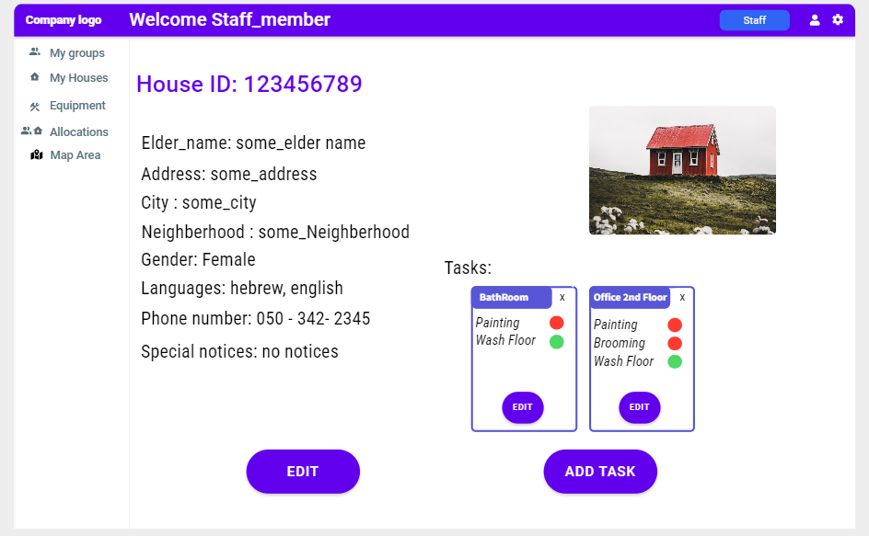
ניהול בית: צפייה ועריכת פרטים
חזרה
Precondition: user is logged in, of type Area/City manager/admin.
User clicks on the “Houses” tab.
The system will view list of all the houses that relevant to the user (houses in assigned neighborhood)
User selects the relevant house that he wants to edit.
User enters the house info page, inside he can view the following house information: House address, name, gender and phone number of the elder, Supplies needed, and special notices including language preferences. Tasks Included.
User clicks on the “ Edit House” option inside the house page.
The user clicks the relevant field he wants to change and inputs his change.
The user clicks on “Save Changes” to save the information in the system.

Slide 17
ניהול בית: הוספה, הסרה ועריכת מטלה
חזרה
Precondition: user is logged in, of type Area/City manager/admin.
User clicks on the “Houses” tab.
The system will view list of all the houses that relevant to the user (houses in assigned neighborhood)
User selects the relevant house that he wants to edit.
User enters the house info page, inside he can view the following house information: House address, name, gender and phone number of the elder, Supplies needed, and special notices including language preferences. Tasks Included if added.
User can click on the “Add Task” option inside the house page (if the task room doesn’t already exist). (then a window similar to next slide’s will appear with room field request)
Alternatively, when a room exists, you can enter window with all the tasks under the room will be available for editing/adding/removing through room’s tasks edit page.

Slide 18
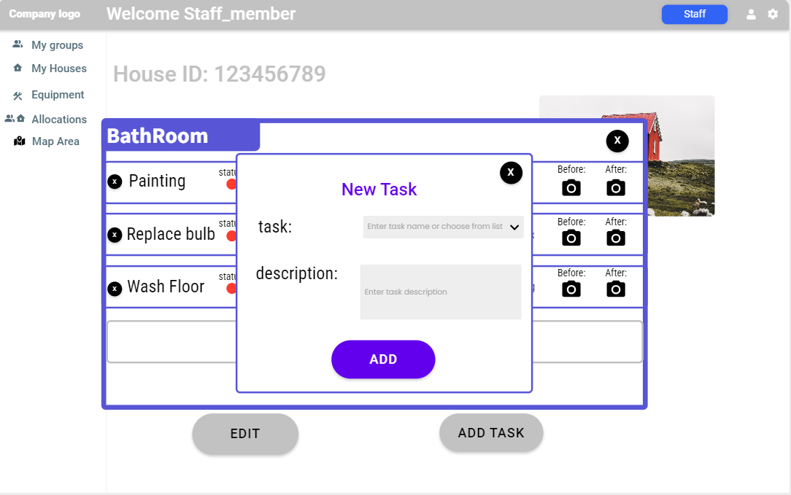
ניהול בית: הוספת מטלה
חזרה
אפשרויות
Precondition: user is logged in, of type Area/City manager/admin.
User clicks on the “Houses” tab.
The system will view list of all the houses that relevant to the user (houses in assigned neighborhood)
User selects the relevant house that he wants to edit.
User enters the house info page, inside he can view the following house information: House address, name, gender and phone number of the elder, Supplies needed, and special notices including language preferences. Tasks Included if added.
User can click on the “Add Task” option inside the house page (if the task room doesn’t already exist). Or edit/add/remove through room’s tasks edit page.
User Choose “+”
The system will view a page with the tasks and following fields: task type, status, room, and free text, place for pics as well.
The user will fill in the details and clicks “Add” .
The task then calculates a list of needed supplies to the current task and adds it to the general supplies needed for the house.

Slide 19
ניהול בית: עריכת מטלה
חזרה
אפשרויות
Precondition: user is logged in, of type Area/City manager/admin.
User clicks on the “Houses” tab.
The system will view list of all the houses that relevant to the user (houses in assigned neighborhood)
User selects the relevant house that he wants to edit.
User enters the house info page, inside he can view the following house information: House address, name, gender and phone number of the elder, Supplies needed, and special notices including language preferences. Tasks Included if added.
User can click on the “Add Task” option inside the house page (if the task room doesn’t already exist). Or edit/add/remove through room’s tasks edit page.
The system will view a page with the tasks and following fields: task type, status, room, and free text, place for pics as well.
The user will select the task he wants to edit and replace the changeable fields inside.
The house general supplies list updated accordingly

Slide 20
ניהול בית: הסרת מטלה
חזרה
אפשרויות
Precondition: user is logged in, of type Area/City manager/admin.
User clicks on the “Houses” tab.
The system will view list of all the houses that relevant to the user (houses in assigned neighborhood)
User selects the relevant house that he wants to edit.
User enters the house info page, inside he can view the following house information: House address, name, gender and phone number of the elder, Supplies needed, and special notices including language preferences. Tasks Included if added.
User can click on the “Add Task” option inside the house page (if the task room doesn’t already exist). Or edit/add/remove through room’s tasks edit page.
The system will view a page with the tasks and following fields: task type, status, room, and free text, place for pics as well.
The user will select the task he wants to delete and choose the delete mark near it.
The house general supplies list updated accordingly

Slide 21
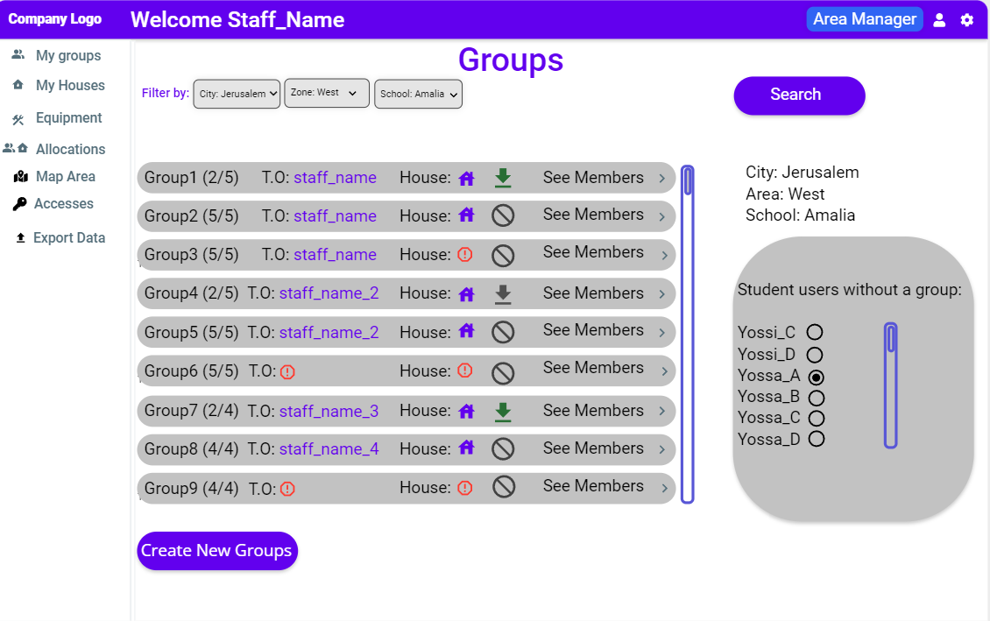
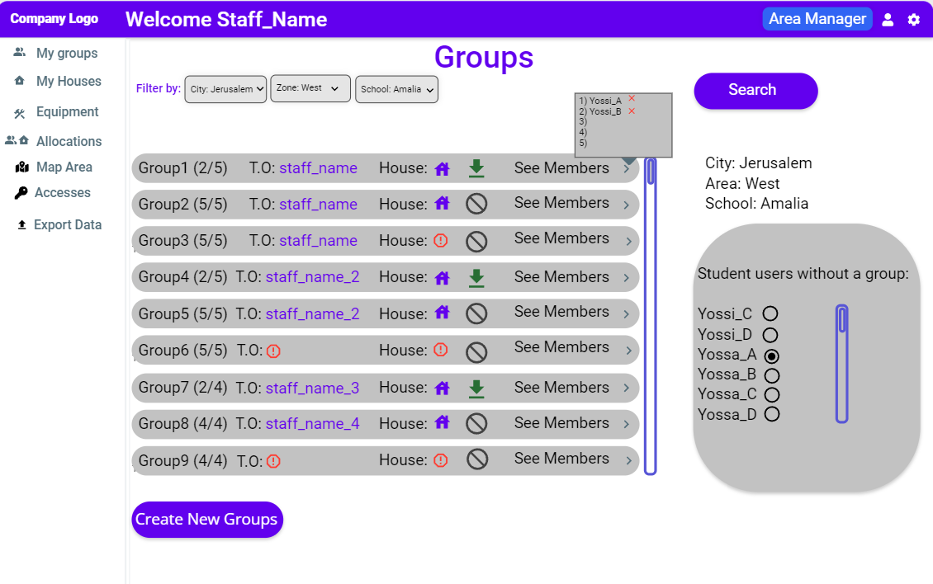
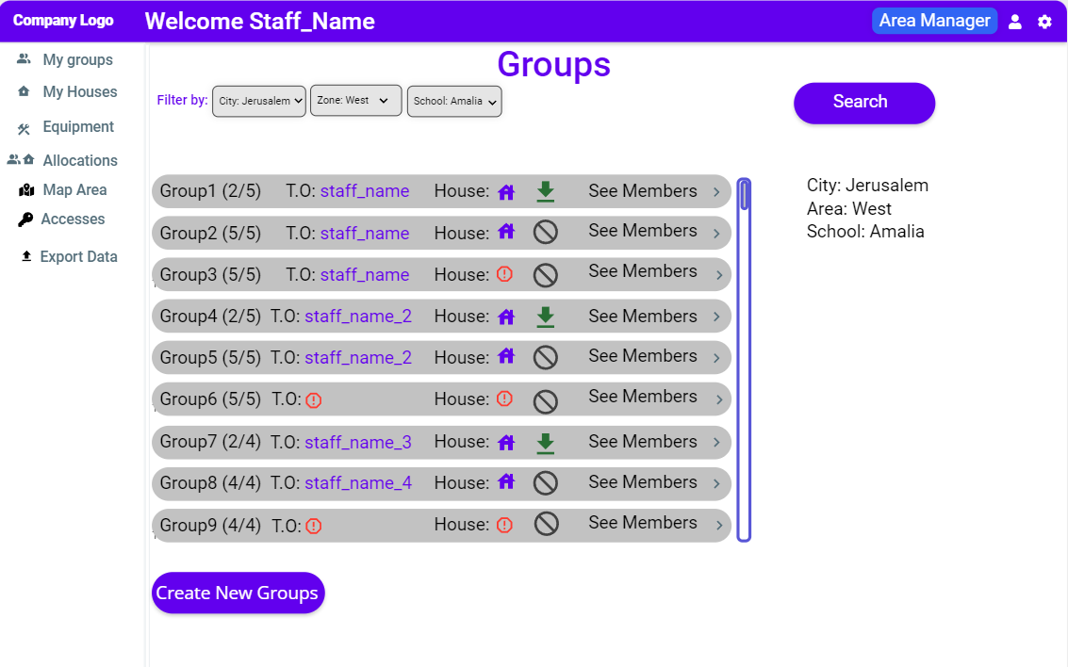
ניהול קבוצה: הוספה והסרת חברי קבוצה
חזרה
Precondition: user is logged in, of type Area/City manager/admin.
User clicks on the “Groups” tab.
The system will view a list of all the groups under the school he filtered by from the schools relevant to the user (in assigned area) and the registered users in the school that aren’t in a group.
The user can do the following actions:
Add Group Member:
User chose the name of the student without a group.
User choose the green mark on a group with available space. (NTH: user can drag & drop)
Remove Group Member
User clicks on the “See members” option on the wanted group he wants to remove from.
The user choose the red X near the user he wants to remove. The system removes the user from the group and now he can be seen in the side list
Assign Team Owner:
User click on the name/red sign near the T.O
And choose from the list of team owners in the area.
The system signs the T.O that was chosen.

Slide 22
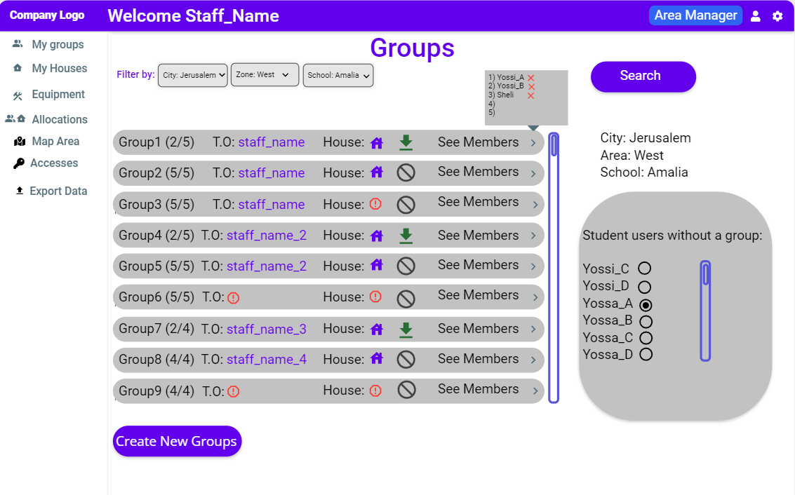
ניהול קבוצה: צפייה בתגובות מיוחדות
חזרה
Precondition: user is logged in, of type Area/City manager/admin.
User clicks on the “Groups” tab.
The system will view a list of all the groups relevant to the user (groups in assigned neighborhood).
User clicks on the name of the student he wants to see his special comments.
The system display the profile page of the student
The user can see the student’s special comments.

Slide 23
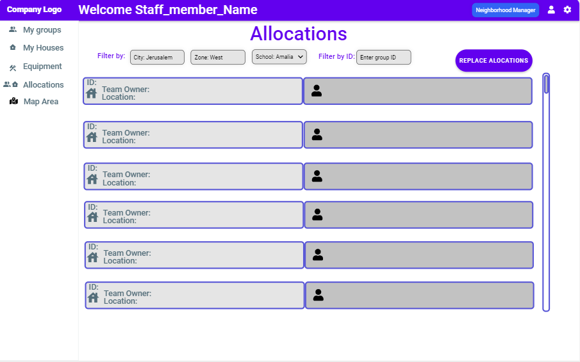
ניהול שיבוץ: שינוי השמה
חזרה
Precondition: user is logged in, of type Area/City manager/admin.
User clicks on the “Allocation” tab.
The system will view a page with pairs of group-house (each group with a house under the group responsibility) that he filtered by school or area.
The user can highlight any two groups and choose Replace Allocations .
Note: Some houses/groups can be without allocation, situation goes the same. still highlight two to replace the “bond”.

Slide 24
פעולות מנהל אזור City Manager

Slide 25
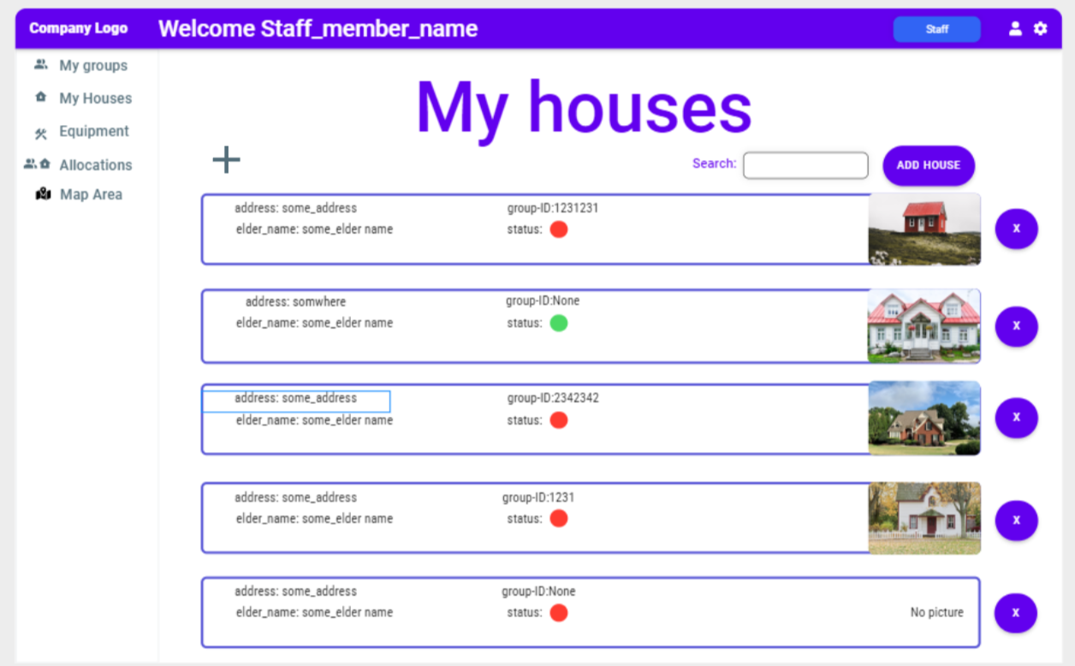
ניהול בית: הוספת בית
חזרה
Precondition: user is logged in, of type City manager/admin.
User clicks on the “Houses” tab.
The system views a page with all the houses that are relevant to the user area.
User clicks on the “Add House” button.
The system prompts a page with a list of the following fields that need to be filled: elderly person’s name, address, phone number, special notices, language preferences and gender identity.
User fills all the relevant details and clicks on “Create House”.

Slide 26
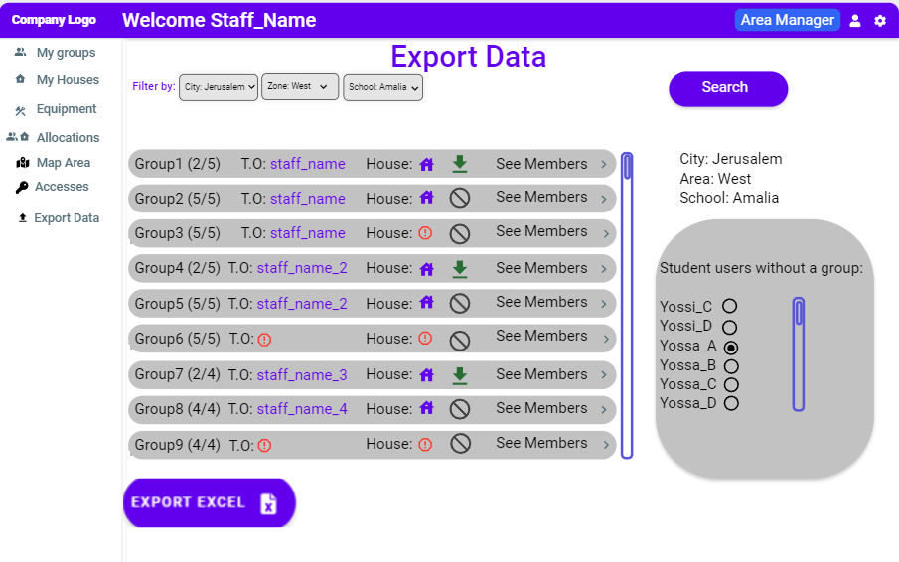

ניהול קבוצה: ייצוא פרטי בית ספר
חזרה
Precondition: user is logged in, of type City manager/admin.
User clicks on “Export” tab.
The system will view all the relevant data under the responsibility of the user.
User clicks on “Export School Information”.
The system will display a page with a list of schools that need to be selected from.
The user choose the school he wants to export information about
The user chooses export excel
7. The system will create an excel document with the following information about a school: student name, email, address of the house he will volunteer at, team owner and area manager.

Slide 27
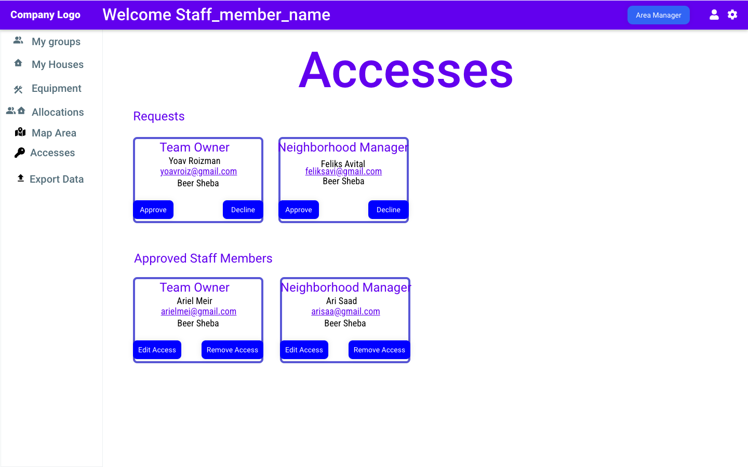
ניהול גישות: אישור בקשה ושינוי גישה קיימת
חזרה
Precondition: user is logged in, of type City manager/admin.
User clicks on the “Accesses” tab.
The system will display all the requests for a role and all the staff members in the system under his authority .
User can click on “Approve” or “Decline” option under the user request
He can also:
Edit Access:
User chooses a staff member he wants to change his role.
User clicks on “Edit Access”.
The system displays a window with a dropdown menu that the user can choose a new access to give to the user.
Remove Access:
User clicks on “Remove Access” on the user he wants to remove his access.

Slide 28
פעולות אדמין

Slide 29
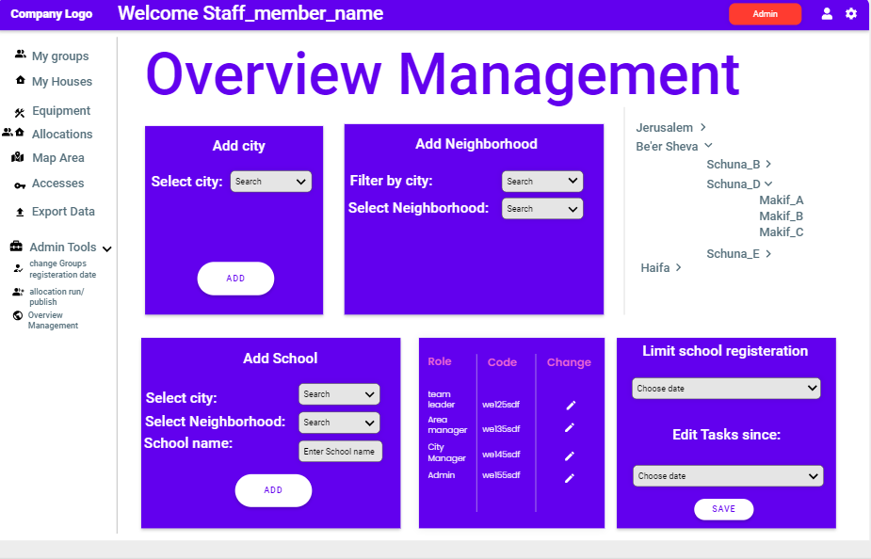
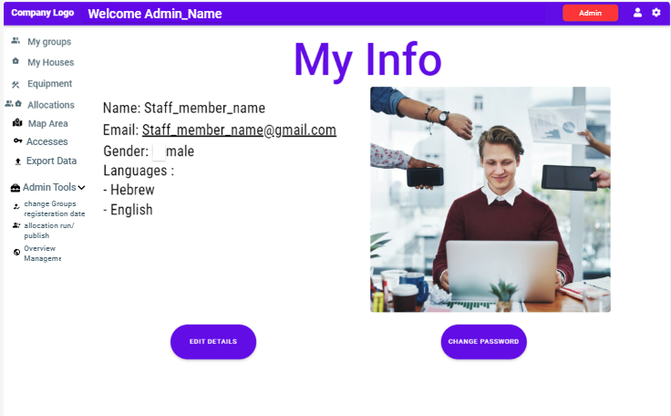
אדמין: שינוי תאריך הגבלת הרישום
חזרה
Precondition: user is logged in, of type “Admin”.
User clicks on the “Admin” tab.
The system will display an admin panel with specific admin options.
Overview Management:
User clicks on “Change Final Date”.
The system will display a calendar.
User chooses a valid date from the calendar.

Slide 30
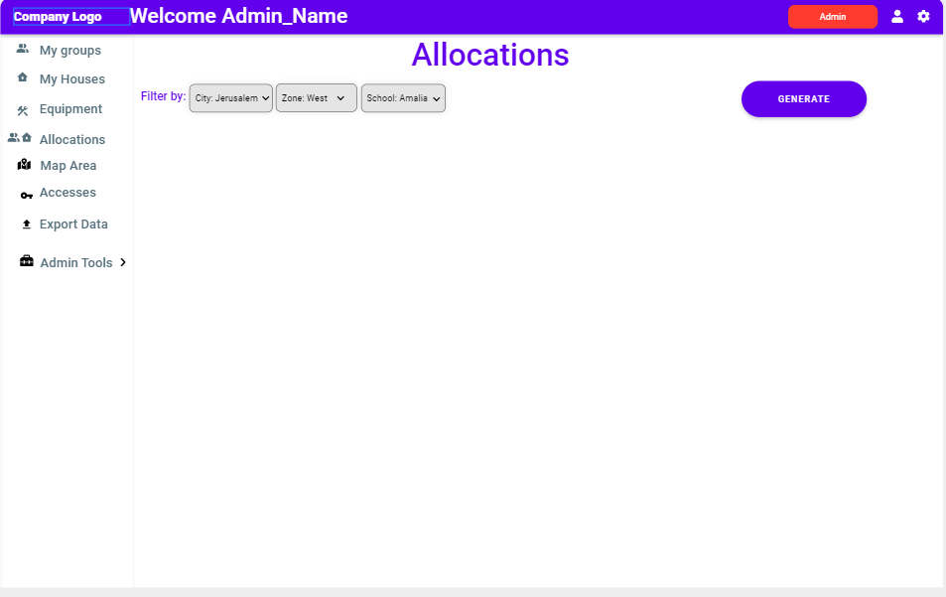
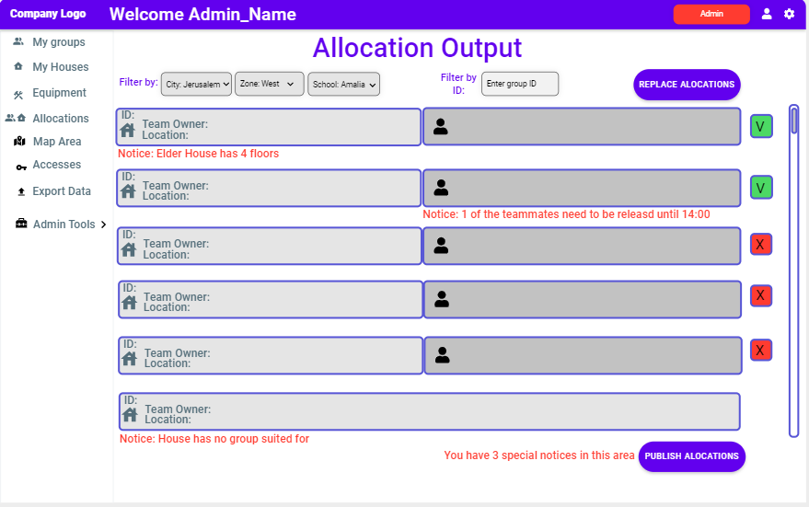
אדמין: הפעלת אלגו' השיבוץ
חזרה
Precondition: user is logged in, of type “Admin”.
User clicks on the “Admin” tab.
The system will display an admin panel with specific admin options.
Run Group-House Allocation:
User clicks on “Run Allocation”
The system will run a group-house allocation algorithm that allocates each house with a group
User can view the allocation under the “Allocation” tab.
The system will show the Admin the groups that need to have a final approval due to special notices

Slide 31
אדמין: פרסום תוצאת השיבוץ
חזרה
Precondition: user is logged in, of type “Admin” after executing and editing an allocation as he sees fit.
User clicks on “Publish Allocation”.
The system will publish the allocation results so all users with the appropriate authority can view the allocation

Slide 32
אדמין: הוספה\הסרה\עריכה של אזור\שכונה\בית-ספר
חזרה
Precondition: user is logged in, of type “Admin”.
User clicks on the “Admin” tab.
The system will display an admin panel with specific admin options.
The Admin chooses a sub-tab “Overview Management”:
Add/Edit/Remove Area/Neighborhood/School:
User clicks on “Add”/ “Edit”/”Remove” in the areas/neighborhoods/school section.
The system will ask an input for the name of the area/neighborhood/school.
User inputs the desired info and clicks “Save Changes”.

Slide 33
אדמין:
מנהל אזור:
רכז גרעין:
חניך גרעין:
תלמיד:
כללי:
התקדמות שיפוץ: זהה לחניך גרעין
1
רישום תלמיד
צפה בקבוצה
הצטרפות לקבוצה
כל תפקידי מנהל האזור ובנוסף:
כל תפקידי רכז הגרעין ובנוסף:
1
1
ניהול בית: צפייה ועריכת פרטים
2
יציאה מקבוצה
2
1
רישום סגל
שינוי תאריך הגבלת הרישום
ניהול בית: הוספת בית
צפייה פרטי בית
2
1
2
ניהול בית: הוספה, הסרה ועריכת מטלה
3
3
2
2
1
הפעלת אלגו' השיבוץ
ניהול קבוצה: ייצוא פרטי בית ספר
ערוך התקדמות קבוצה
צפייה בפרטי בית
התחברות
1
1
ניהול קבוצה: הוספה והסרת חברי קבוצה
2
1
2
ערוך פרטים אישיים
פרסום שיבוץ
3
ניהול גישות: טיפול בבקשה
1
ניהול קבוצה: צפייה בתגובות מיוחדות
הוספה\הסרה\ עריכה של אזור\שכונה\ בית ספר
3
1
2
ניהול קבוצה: השמת ראש קבוצה
ניהול גישות: שינוי גישה
3
ניהול שיבוץ: שינוי השמה
3
Optional, might be manual
כל הפעולות מצומצמות לאזור האחריות של התפקיד

